Slide 1
Probabilistic Robotics: Kalman Filters
Sebastian Thrun & Alex Teichman
Stanford Artificial Intelligence Lab
Slide credits: Wolfram Burgard, Dieter Fox, Cyrill Stachniss, Giorgio Grisetti, Maren Bennewitz, Christian Plagemann, Dirk Haehnel, Mike Montemerlo, Nick Roy, Kai Arras, Patrick Pfaff and others

Slide 2
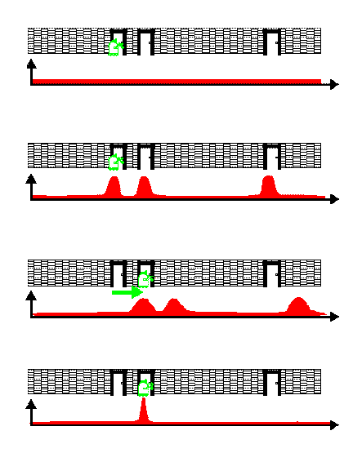
Bayes Filters in Localization

Slide 3
Bayes Filter Reminder
Prediction
Measurement Update

Slide 4
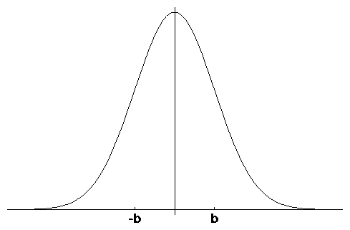
Gaussians
μ
Univariate
-σ
σ
μ
Multivariate

Slide 5
Properties of Gaussians

Slide 6
Multivariate Gaussians
We stay in the “Gaussian world” as long as we start with Gaussians and perform only linear transformations.

Slide 7
Discrete Kalman Filter
Estimates the state x of a discrete-time controlled process that is governed by the linear stochastic difference equation
with a measurement

Slide 8
Components of a Kalman Filter
Matrix (nxn) that describes how the state evolves from t to t-1 without controls or noise.
Matrix (nxl) that describes how the control u_{t} changes the state from t to t-1.
Matrix (kxn) that describes how to map the state x_{t} to an observation z_{t}.
Random variables representing the process and measurement noise that are assumed to be independent and normally distributed with covariance R_{t} and Q_{t} respectively.

Slide 9
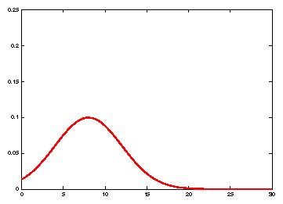
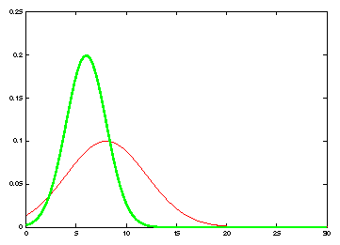
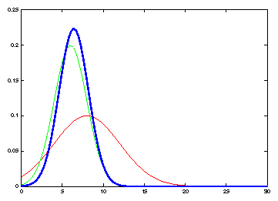
Kalman Filter Updates in 1D

Slide 10
Kalman Filter Updates in 1D

Slide 11
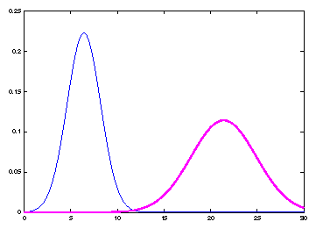
Kalman Filter Updates in 1D

Slide 12
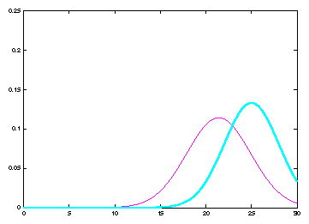
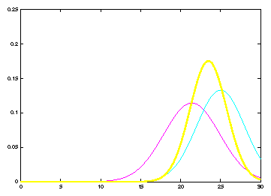
Kalman Filter Updates

Slide 13
Linear Gaussian Systems: Initialization
Initial belief is normally distributed:

Slide 14
Linear Gaussian Systems: Dynamics
Dynamics are linear function of state and control plus additive noise:

Slide 15
Linear Gaussian Systems: Dynamics
Notes:
This equation can be derived by just looking at the linear function of a Gaussian (ax+bu) and a convolution of two Gaussians

Slide 16
Linear Gaussian Systems: Observations
Observations are linear function of state plus additive noise:

Slide 17
Linear Gaussian Systems: Observations
Notes:
Just the multiplication of two Gaussians (ignore c matrix to make it easier
To derive mean, multiply K = sigma / sigma * q into the equation, expand the left mean by sigma + q / sigma + q
To derive variance, same approach: expand left sigma with sigma + q / sigma + q

Slide 18
Kalman Filter Algorithm
Algorithm Kalman_filter( μ_{t-1}, Σ_{t-1}, u_{t}, z_{t}):
Prediction:
Correction:
Return μ_{t}, Σ_{t}

Slide 19
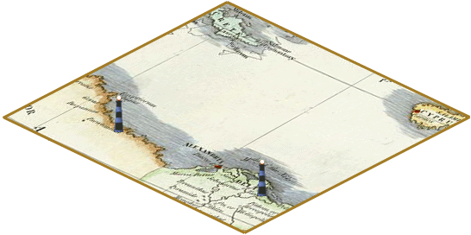
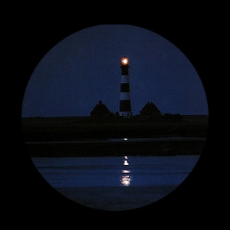
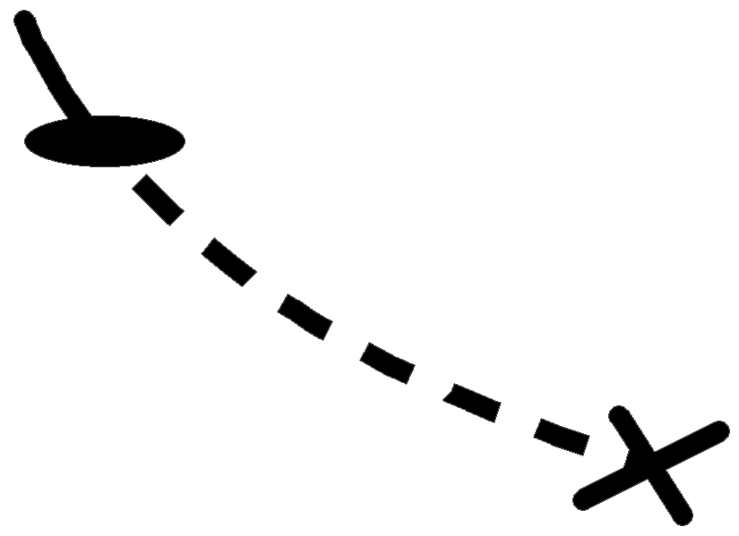



Kalman Filter Algorithm

Slide 20
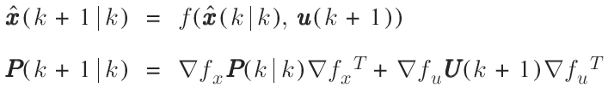

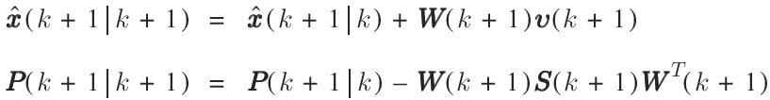
Kalman Filter Algorithm
Prediction
Observation
Correction
Matching

Slide 21
The Prediction-Correction-Cycle
Prediction

Slide 22
The Prediction-Correction-Cycle
Correction

Slide 23
The Prediction-Correction-Cycle
Prediction
Correction

Slide 24
Kalman Filter Summary
Highly efficient: Polynomial in measurement dimensionality k and state dimensionality n: O(k^{2.376} + n²)
Optimal for linear Gaussian systems!
Most robotics systems are nonlinear!

Slide 25
Nonlinear Dynamic Systems
Most realistic robotic problems involve nonlinear functions

Slide 26
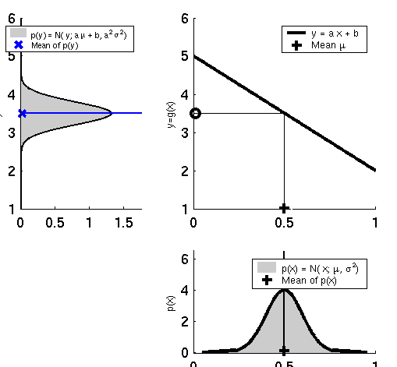
Linearity Assumption Revisited

Slide 27
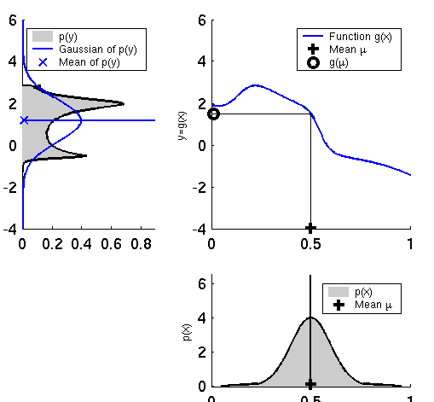
Non-linear Function

Slide 28
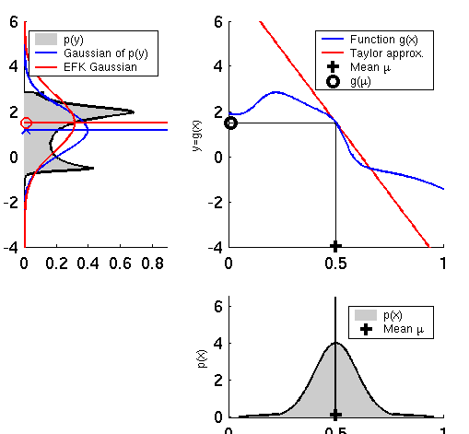
EKF Linearization (1)

Slide 29
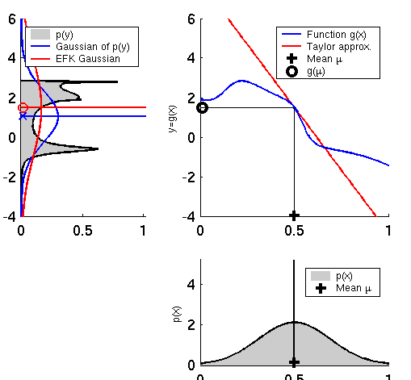
EKF Linearization (2)

Slide 30
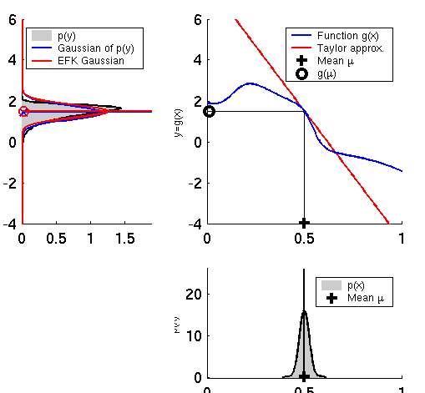
EKF Linearization (3)

Slide 31
EKF Linearization: First Order Taylor Series Expansion
Prediction:
Correction:

Slide 32
EKF Algorithm
Extended_Kalman_filter( μ_{t-1}, Σ_{t-1}, u_{t}, z_{t}):
Prediction:
Correction:
Return μ_{t}, Σ_{t}

Slide 33
Localization
“Using sensory information to locate the robot in its environment is the most fundamental problem to providing a mobile robot with autonomous capabilities.” [Cox ’91]
Given
Map of the environment.
Sequence of sensor measurements.
Wanted
Estimate of the robot’s position.
Problem classes
Position tracking
Global localization
Kidnapped robot problem (recovery)

Slide 34
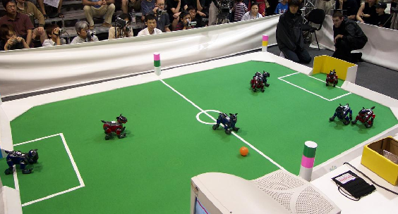
Landmark-based Localization

Slide 35
EKF_localization ( μ_{t-1}, Σ_{t-1}, u_{t}, z_{t}, m): Prediction:
Jacobian of g w.r.t location
Jacobian of g w.r.t control
Motion noise
Predicted mean
Predicted covariance

Slide 36
EKF_localization ( μ_{t-1}, Σ_{t-1}, u_{t}, z_{t}, m): Correction:
Predicted measurement mean
Jacobian of h w.r.t location
Pred. measurement covariance
Kalman gain
Updated mean
Updated covariance

Slide 37
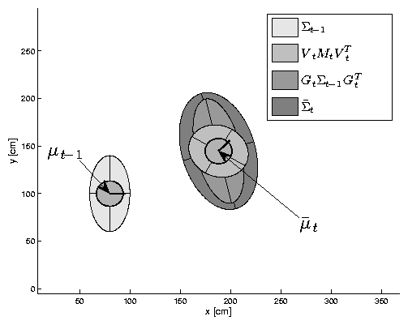
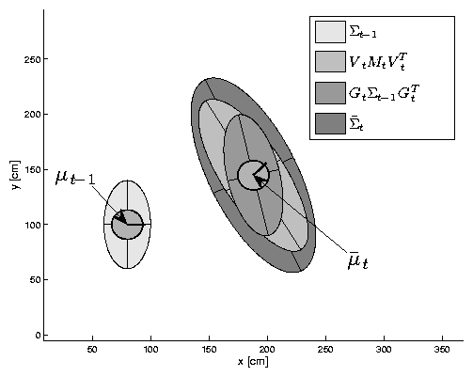
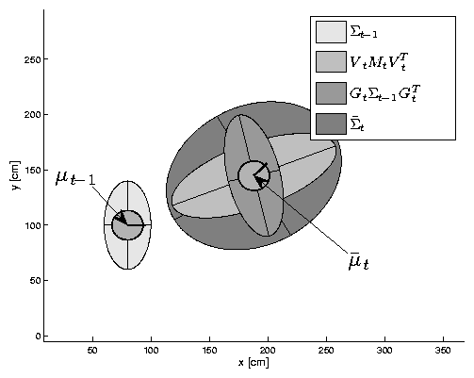
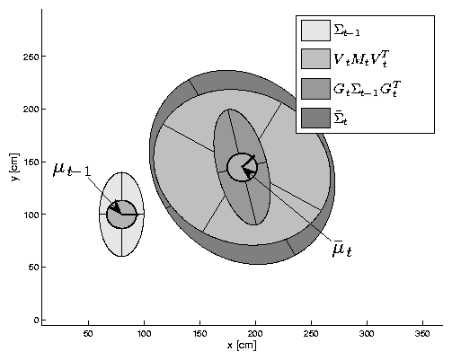
EKF Prediction Step

Slide 38
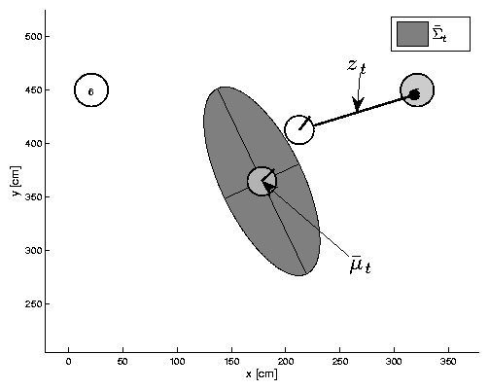
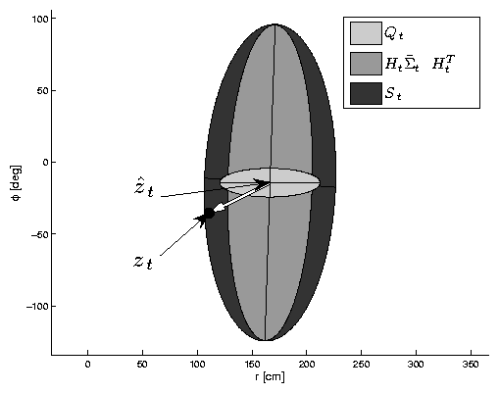
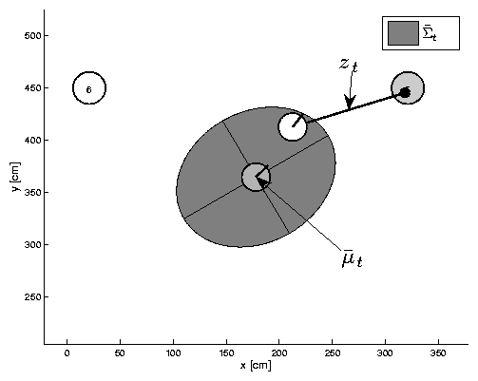
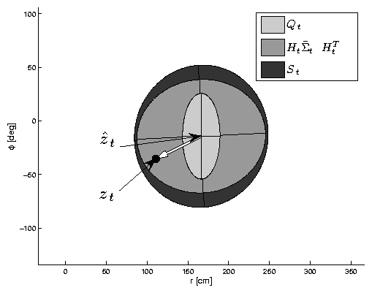
EKF Observation Prediction Step

Slide 39
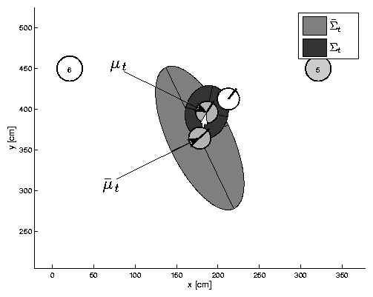
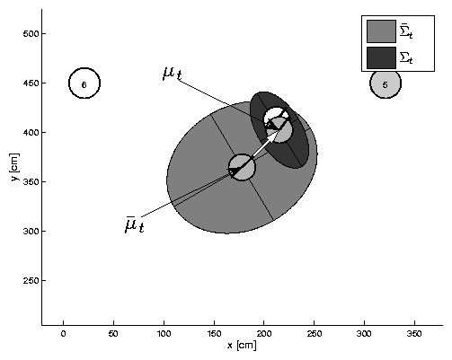
EKF Correction Step

Slide 40
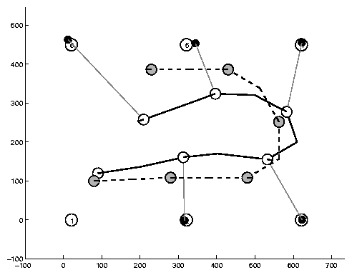
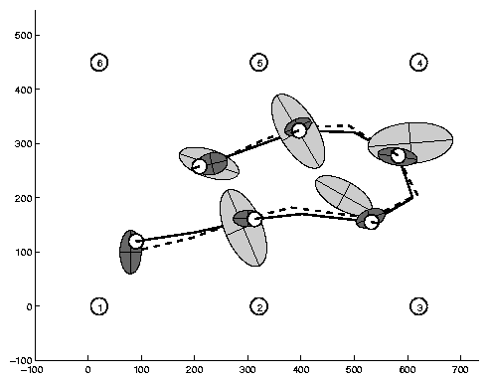
Estimation Sequence (1)

Slide 41
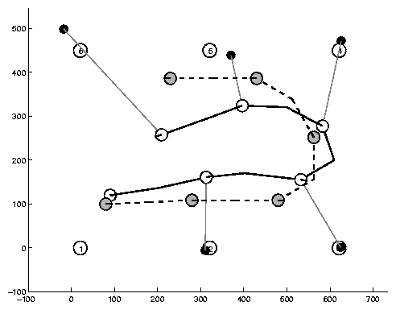
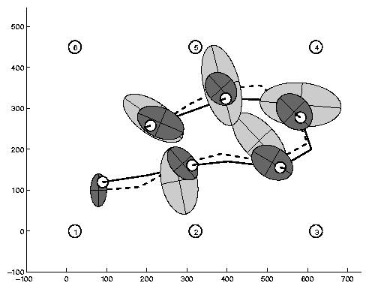
Estimation Sequence (2)

Slide 42
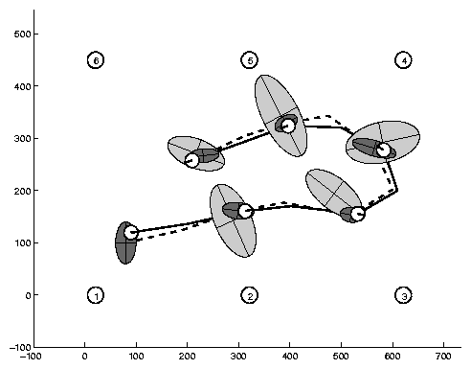
Comparison to GroundTruth

Slide 43
EKF Summary
Highly efficient: Polynomial in measurement dimensionality k and state dimensionality n: O(k^{2.376} + n²)
Not optimal!
Can diverge if nonlinearities are large!
Works surprisingly well even when all assumptions are violated!

Slide 44
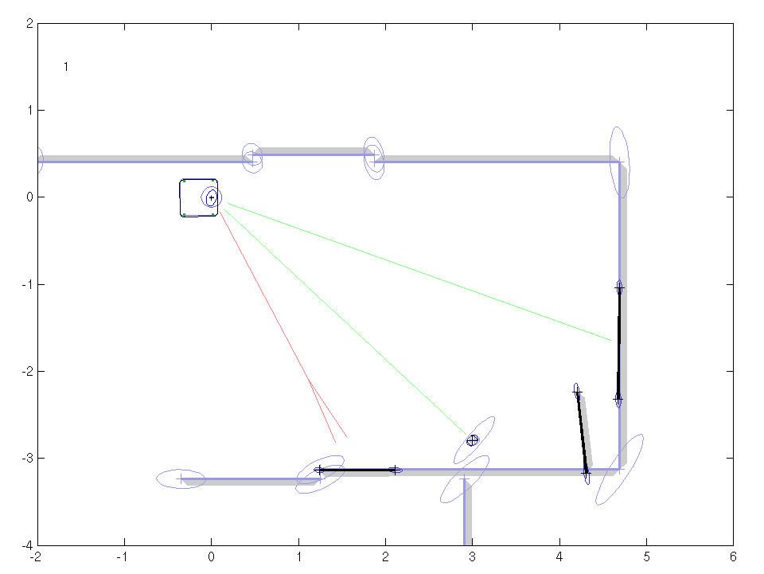
EKF Localization Example
Line and point landmarks

Slide 45
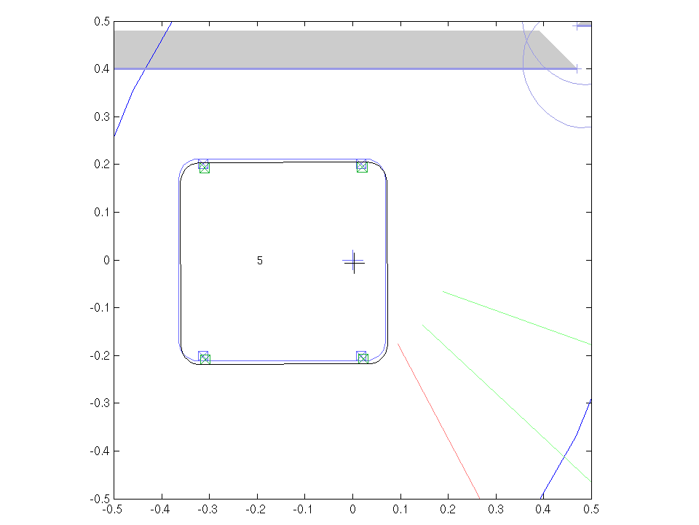
EKF Localization Example
Line and point landmarks

Slide 46
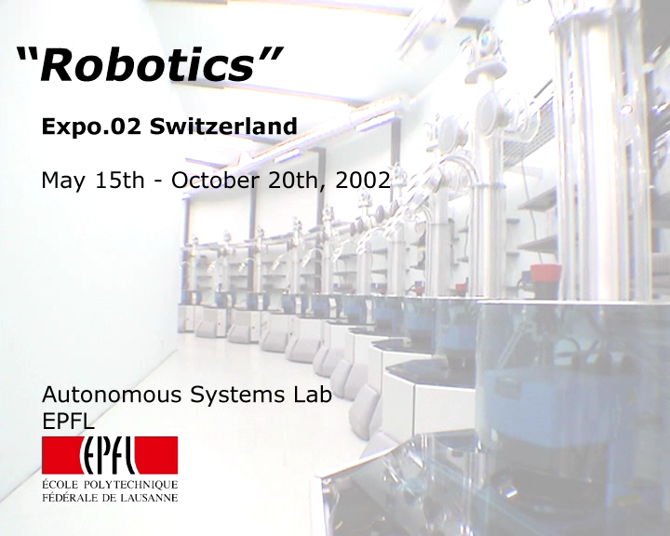
EKF Localization Example
Lines only (Swiss National Exhibition Expo.02)

Slide 47
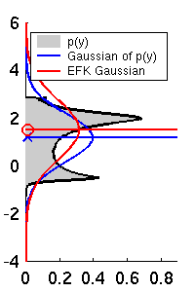
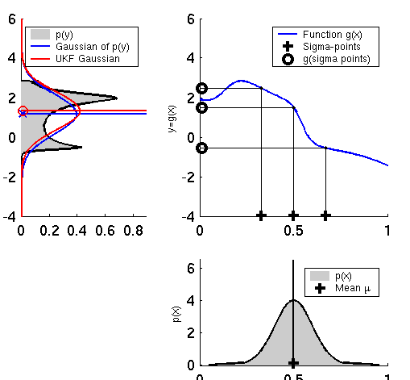
Linearization via Unscented Transform
EKF
UKF

Slide 48
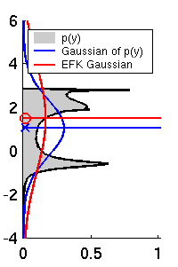
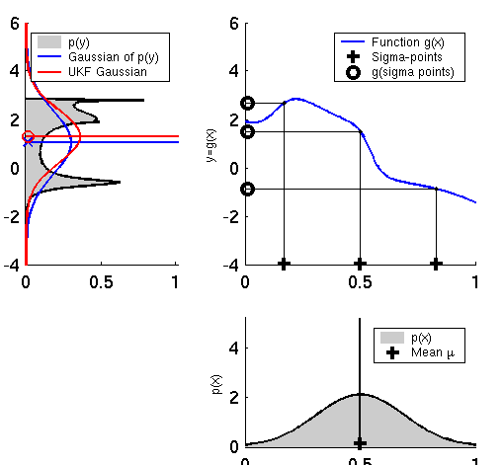
UKF Sigma-Point Estimate (2)
EKF
UKF

Slide 49
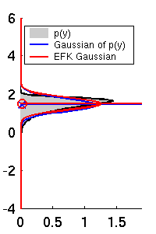
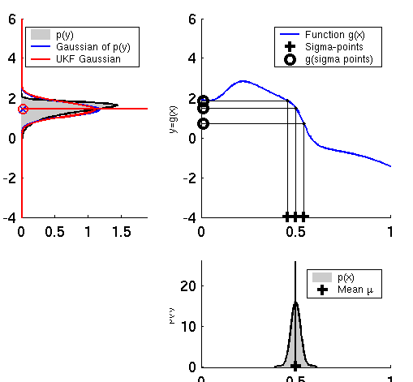
UKF Sigma-Point Estimate (3)
EKF
UKF

Slide 50
Unscented Transform
Sigma points Weights
Pass sigma points through nonlinear function
Recover mean and covariance

Slide 51
UKF_localization ( μ_{t-1}, Σ_{t-1}, u_{t}, z_{t}, m):
Prediction:
Motion noise
Measurement noise
Augmented state mean
Augmented covariance
Sigma points
Prediction of sigma points
Predicted mean
Predicted covariance

Slide 52
UKF_localization ( μ_{t-1}, Σ_{t-1}, u_{t}, z_{t}, m):
Correction:
Measurement sigma points
Predicted measurement mean
Pred. measurement covariance
Cross-covariance
Kalman gain
Updated mean
Updated covariance

Slide 53
EKF_localization ( μ_{t-1}, Σ_{t-1}, u_{t}, z_{t}, m): Correction:
Predicted measurement mean
Jacobian of h w.r.t location
Pred. measurement covariance
Kalman gain
Updated mean
Updated covariance
Notes:
Sigma – k h sigma = sigma – k s k

Slide 54
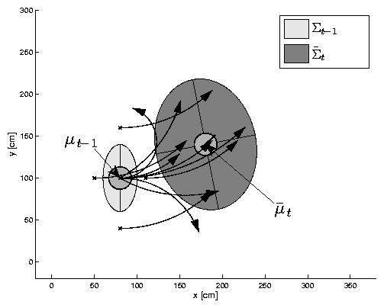
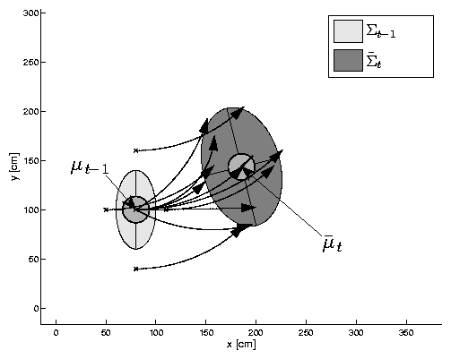
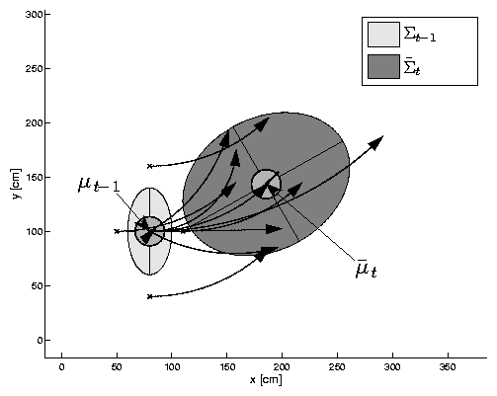
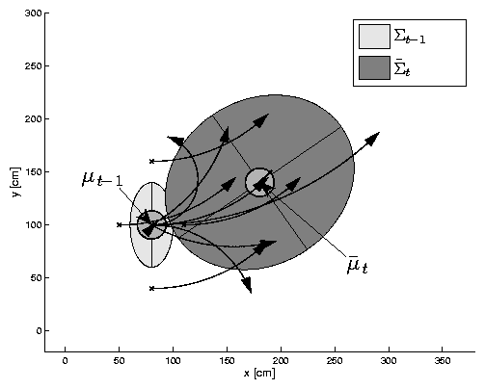
UKF Prediction Step

Slide 55
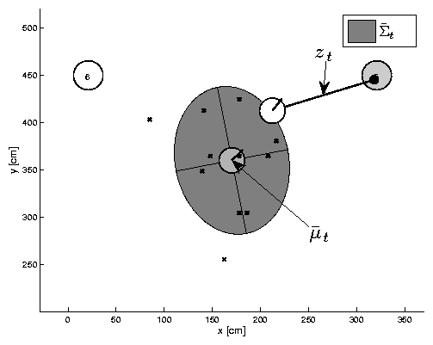
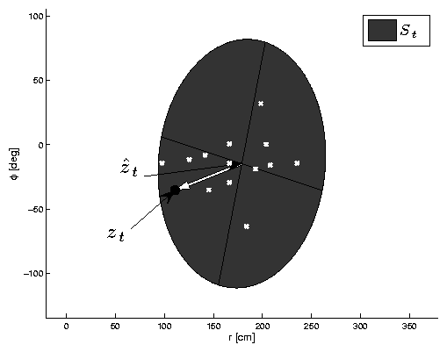

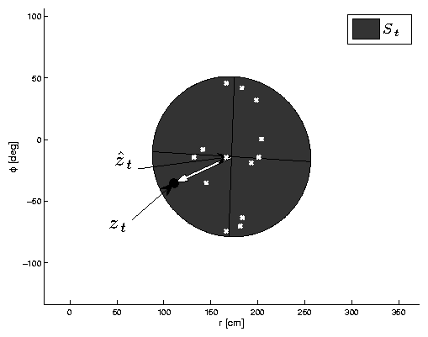
UKF Observation Prediction Step

Slide 56


UKF Correction Step

Slide 57
EKF Correction Step

Slide 58

Estimation Sequence
EKF PF UKF

Slide 59
Estimation Sequence
EKF UKF

Slide 60


Prediction Quality
EKF UKF

Slide 61
UKF Summary
Highly efficient: Same complexity as EKF, with a constant factor slower in typical practical applications
Better linearization than EKF: Accurate in first two terms of Taylor expansion (EKF only first term)
Derivative-free: No Jacobians needed
Still not optimal!

Slide 62

Kalman Filter-based System
[Arras et al. 98]:
Laser range-finder and vision
High precision (<1cm accuracy)
Courtesy of K. Arras

Slide 63




Multi- hypothesis Tracking

Slide 64
Localization With MHT
Belief is represented by multiple hypotheses
Each hypothesis is tracked by a Kalman filter
Additional problems:
Data association: Which observation corresponds to which hypothesis?
Hypothesis management: When to add / delete hypotheses?
Huge body of literature on target tracking, motion correspondence etc.

Slide 65
MHT: Implemented System (1)
Hypotheses are extracted from LRF scans
Each hypothesis has probability of being the correct one:
Hypothesis probability is computed using Bayes’ rule
Hypotheses with low probability are deleted.
New candidates are extracted from LRF scans.
[Jensfelt et al. ’00]

Slide 66


MHT: Implemented System (2)
Courtesy of P. Jensfelt and S. Kristensen

Slide 67


MHT: Implemented System (3) Example run
# hypotheses
P(H_{best})
Map and trajectory
#hypotheses vs. time
Courtesy of P. Jensfelt and S. Kristensen

Slide 68
Summary: Kalman Filter
Gaussian Posterior, Gaussian Noise, efficient when applicable
KF: Motion, Sensing = linear
EKF: nonlinear, uses Taylor expansion
UKF: nonlinear, uses sampling
MHKF: Combines best of Kalman Filters and particle filters
A little challenging to implement

